Slide 1
B2B Portal Training Materials

Slide 2
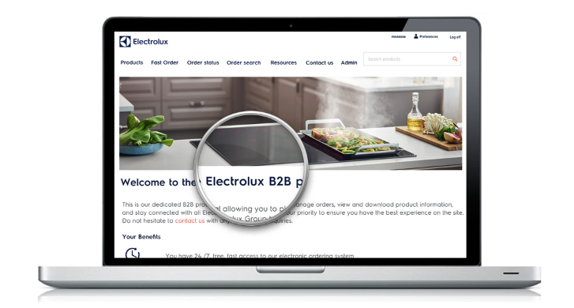
Outline
Electrolux B2B portal – Features & Benefits
Main Menu
A. Product views
Navigation
Product List
Product Detail
Product Search
B. Order Placement:
  Standard flow
  Multiline basket
  Checkout
  E. Additional Resources:
  Sales Folder
  Document downloads
  News & inspiration
C. Order status management:
  Order status
  Order search
  Order details
  D. User management:
  Edit preferences
  Company admin view
  Create user

Slide 3




The Electrolux B2B portal
Features & Benefits
Immediate access to product availability, prices, order placement, order & delivery follow-up
Easy to use
Free-of-charge for all Electrolux retailers
Registration via Tradeplace / Your local contact in the Customer Service team

Slide 4
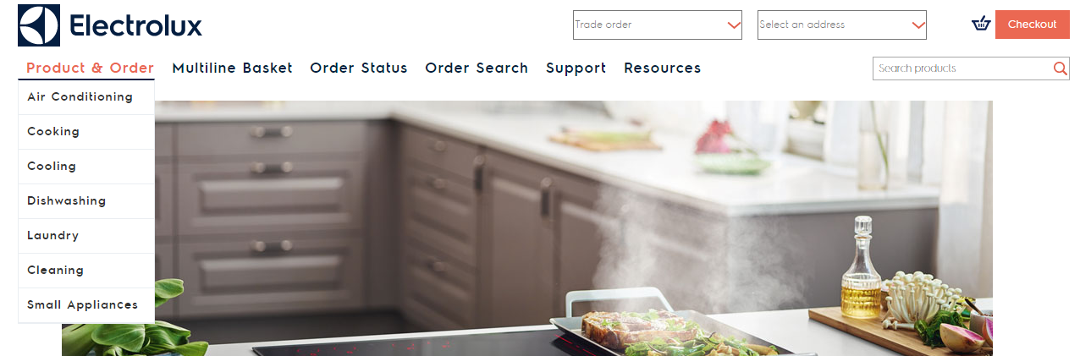
Main Menu
From the home page, you can access the different B2B pages/functions via the top menu:
Under Product & Order section you can browse products by category
Under Order Status you can track your open orders and view placed order details
On the Support page, you can find contact information for our
departments
The Multiline Basket allows you to key-in and upload products to your basket for a faster checkout
Via Order Search you can search for past closed orders and associated documents (invoice, POD).

Slide 5
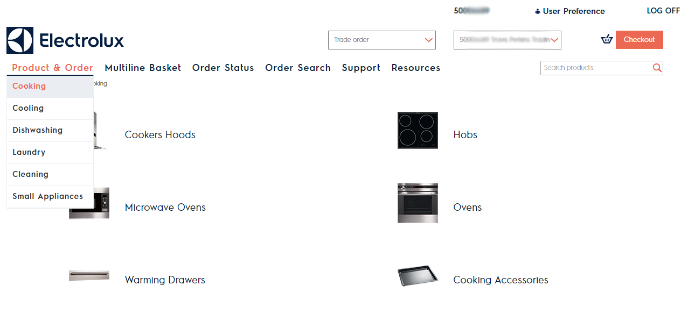
Product Views: Product Navigation
Under Product &Order you can browse the main product categories
All product subcategories are listed. Clicking through you can access the product list

Slide 6
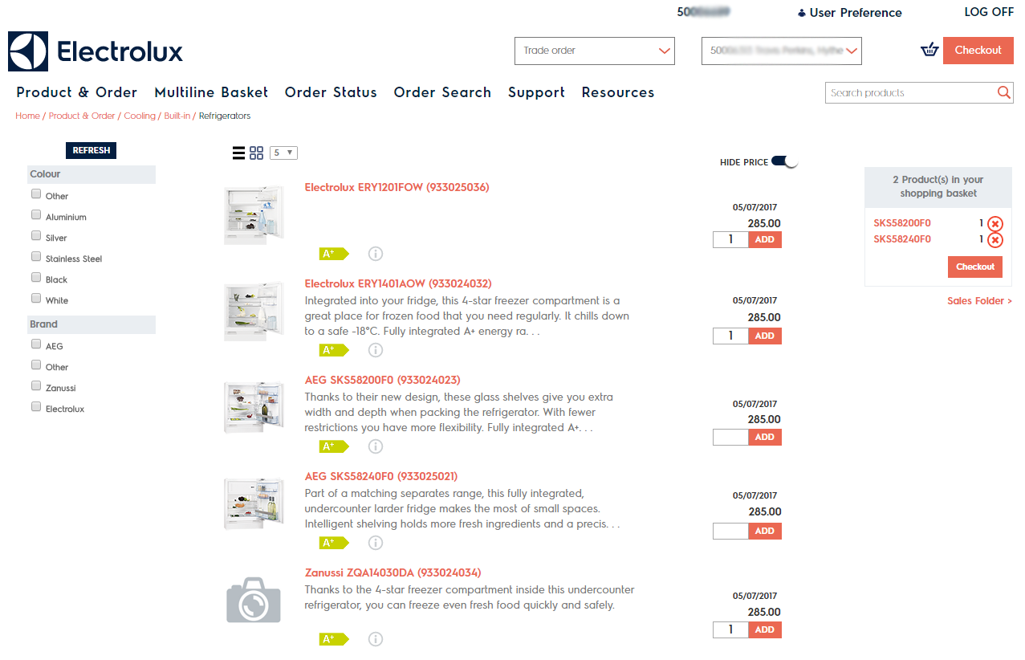
Product Views: Product List
Product search by Model or PNC
Use the filters & the Refresh button to refine the list of products .
Checking out you will land on the order placement page, where you can confirm & place the order
Click-through on the product model to view the complete product specifications
Product price & availability are updated in real time from our ERP system

Slide 7
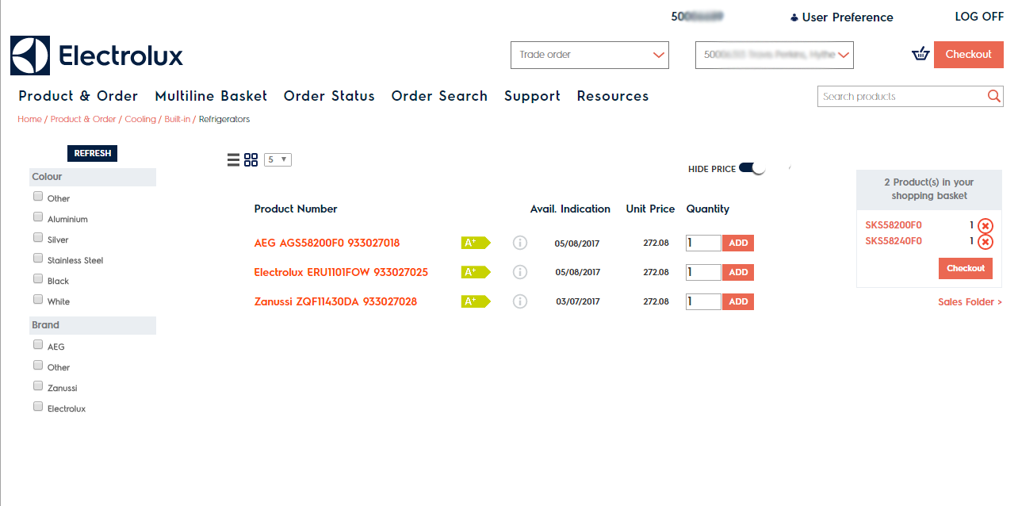
Product Views: Product List - Simple
You can switch view modes from the icons at the top.
The simple product list mode offers a compact view of the products with the essential details. The same filtering & checkout options are available.
You can show/hide the product price, so you can navigate the site in store with your customers
You can download the EU energy label and product fiche by clicking the icons next to the product

Slide 8
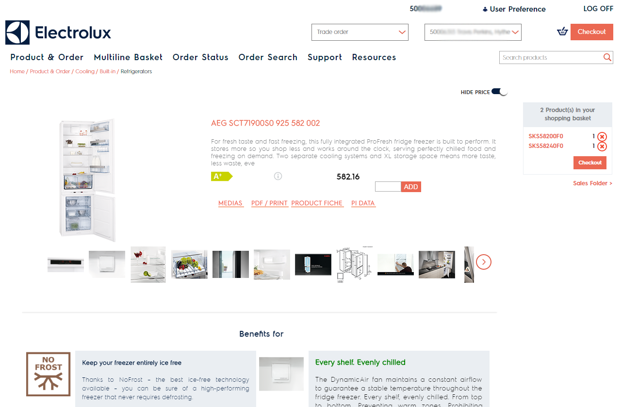
Product Views: Product Detail
The links under product description download the product specifications in various formats. The Media link opens a list of asset links grouped by type.
View product media. Clicking on the thumbnails opens a popup where you can select your preferred size & resolution for download
You can read the benefits, features technical specifications and download the user manuals further down the page

Slide 9
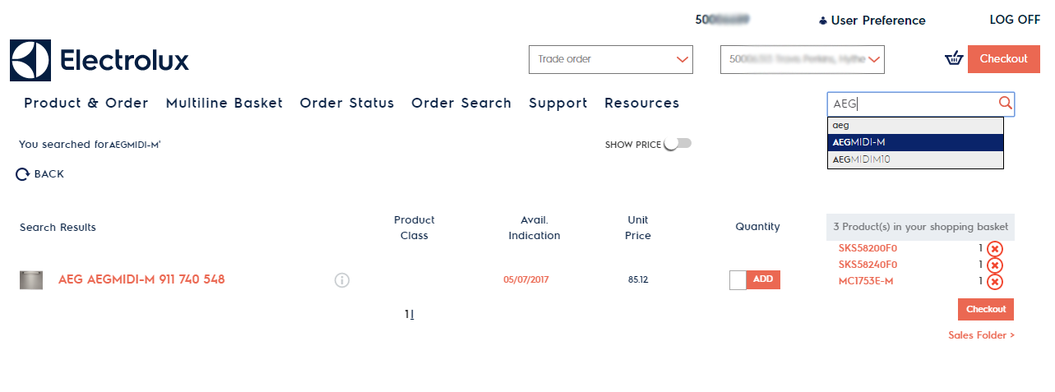
Product Views: Product Search
Search by product code and select from the auto-complete suggestions
View more product details by clicking on the results
Add products to your basket directly from the search result

Slide 10
Order placement: Standard mode
Products currently in your basket are visible on the right-hand side.
You can add products to the basket using the Add button next to the product

Slide 11
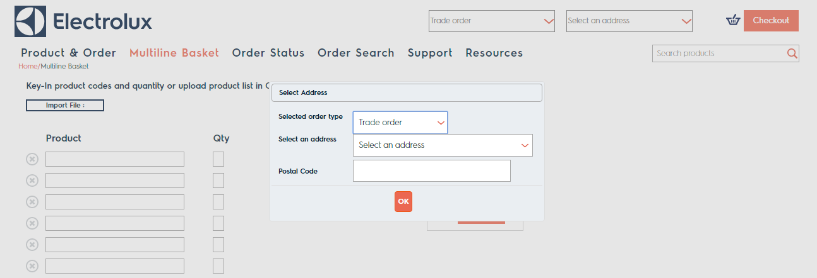
Order placement: Multiline Basket
At any point during your checkout you can edit the order type and address from the top dropdowns.
Before accessing a list of products, or using the multiline basket, a selection of the order type and address is required.

Slide 12
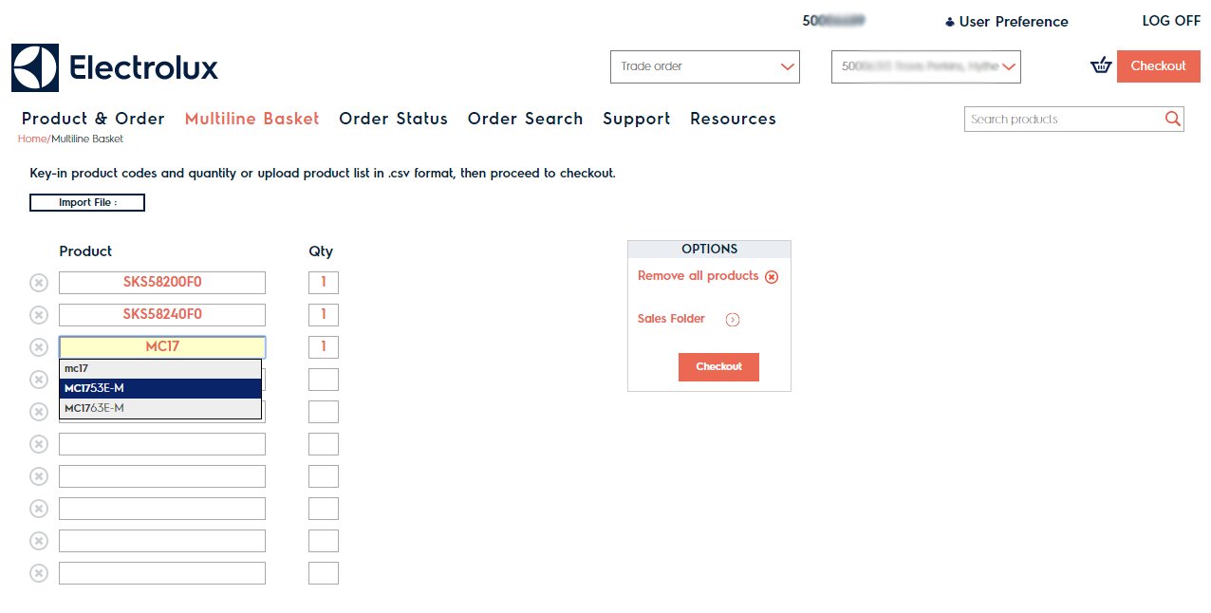
Order placement: Multiline Basket
You can upload a .csv file containing product code or model in 1st column and quantity in the 2nd
You can key-in product codes and select products from the predictive text displayed

Slide 13
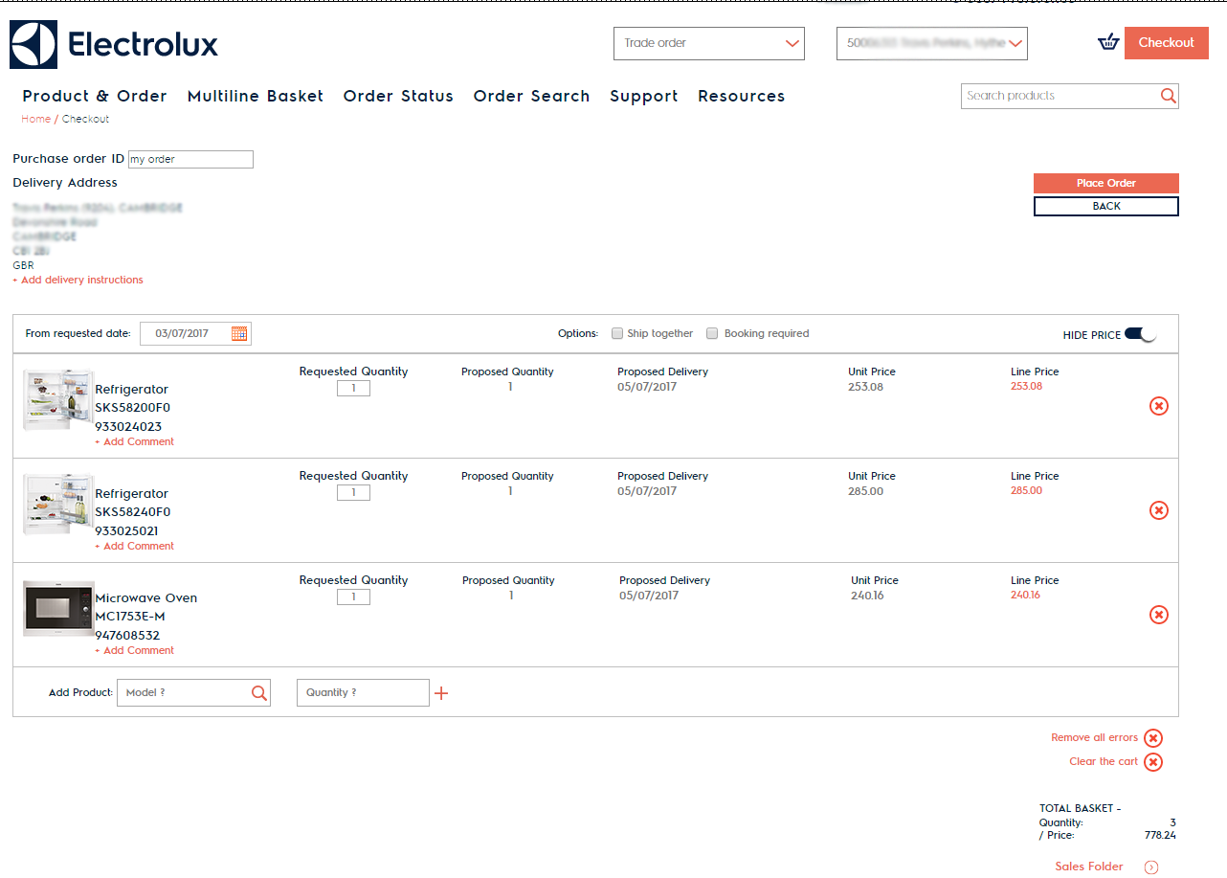
Order placement: Checkout
You can now also change the order type and delivery address on the checkout page
Fill in your own order reference
Submits the order into our system
Select your preferred delivery date
View complete pricing details opening the price popup
You can add more products to the basket
You can review your order total

Slide 14
Order placement: Checkout
You can add more delivery details
You can return to the previous page
You can use additional order options:
- to ship together all products in the basket;
- to have the order delivery confirmed by our customer service staff first
If any products added return errors, you can remove them altogether
All products in your cart can be added to a brochure – the layout of which you can confirm on the next page

Slide 15
Order placement: Checkout
You can add more delivery details
You can return to the previous page
You can use additional order options:
- to ship together all products in the basket;
- to have the order delivery confirmed by our customer service staff first
If any products added return errors, you can remove them altogether
All products in your cart can be added to a brochure – the layout of which you can confirm on the next page

Slide 16
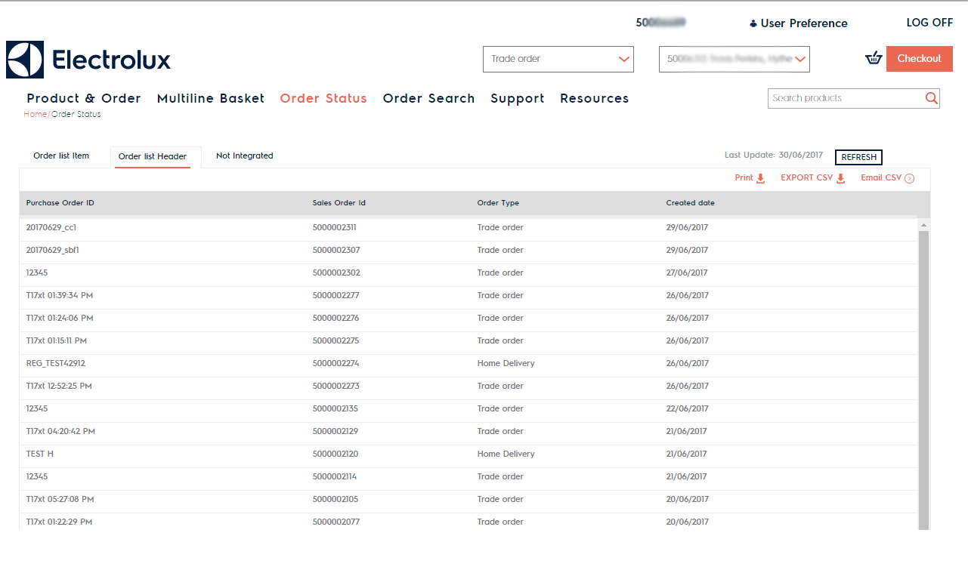
Order placement: Order Status
You can export the entire list by Printing it to pdf, exporting as csv or sending it by email
Order status offers you a dashboard view of all your open orders by order type
Sort the results by clicking the column headers

Slide 17
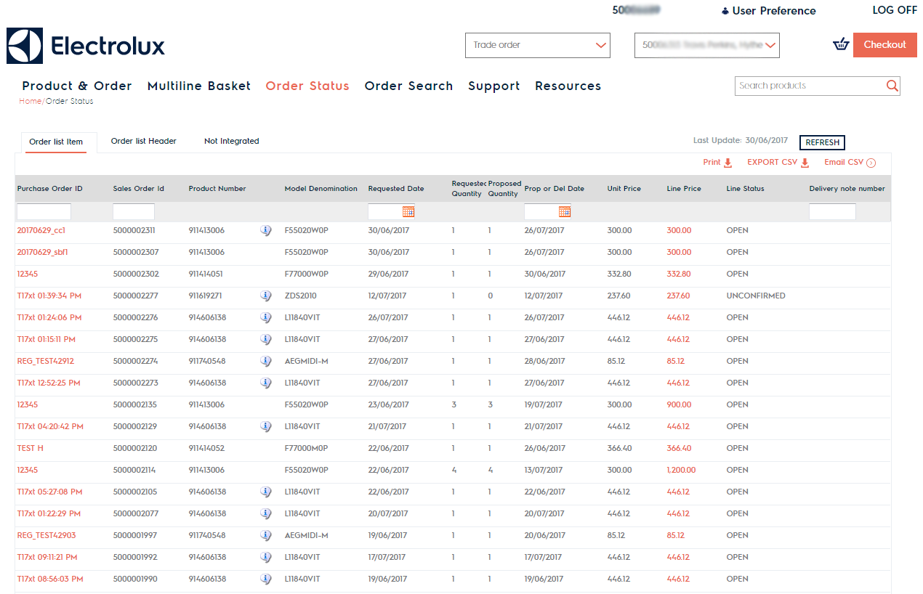
Order placement: Order Status
View more order details using the Order list item view, including each line of products ordered and associated details
You can refresh the list to get the latest info from our ERP
Sort the results by clicking the column headers
Search within the column using the input field at the top
Click on the order line to get the full order details

Slide 18
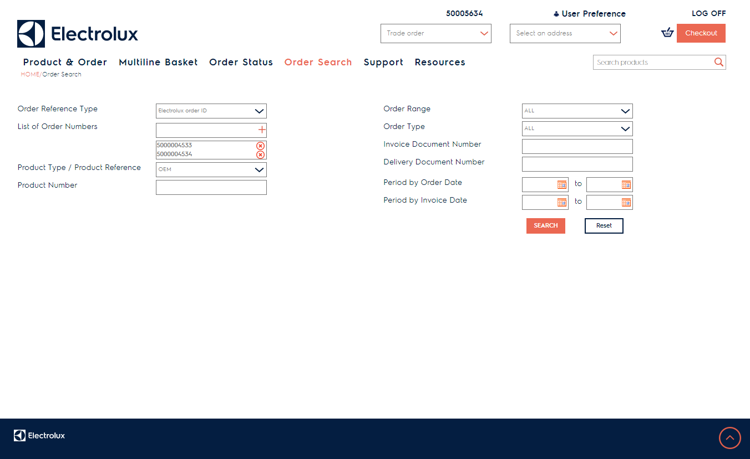
Order search
You can search by one or multiple order numbers – you can use either the Electrolux order ID or your own purchase order ID
You can limit your search to a certain order range: searching through all, closed or open orders, or a certain order type: e.g. standard order, home delivery, site order
You can search by products within the order – using Electrolux product numbers (OEM) or the product EAN
You can search by documents attached to an order – invoice or proof of delivery document.
You can also limit the time frame of your search – by date of order placement or date the invoice was issued

Slide 19
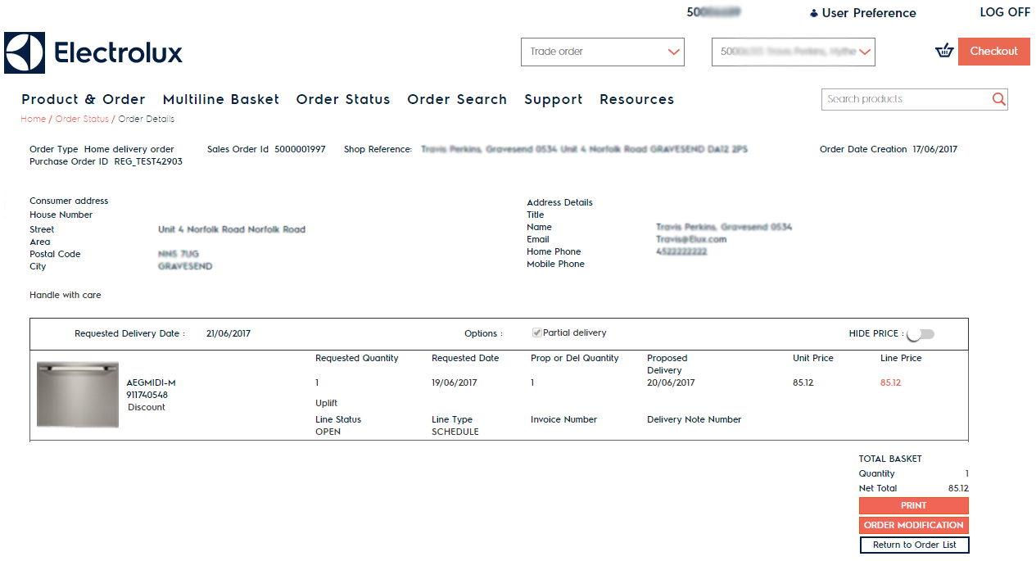
Order placement: Order Detail
View all the order details originally confirmed
Print the complete order details
You can modify the details of an already placed order
View the status of each order line and relevant details regarding delivery and invoicing
Return to the Order status or Order search depending on where you accessed the order detaiil from

Slide 20
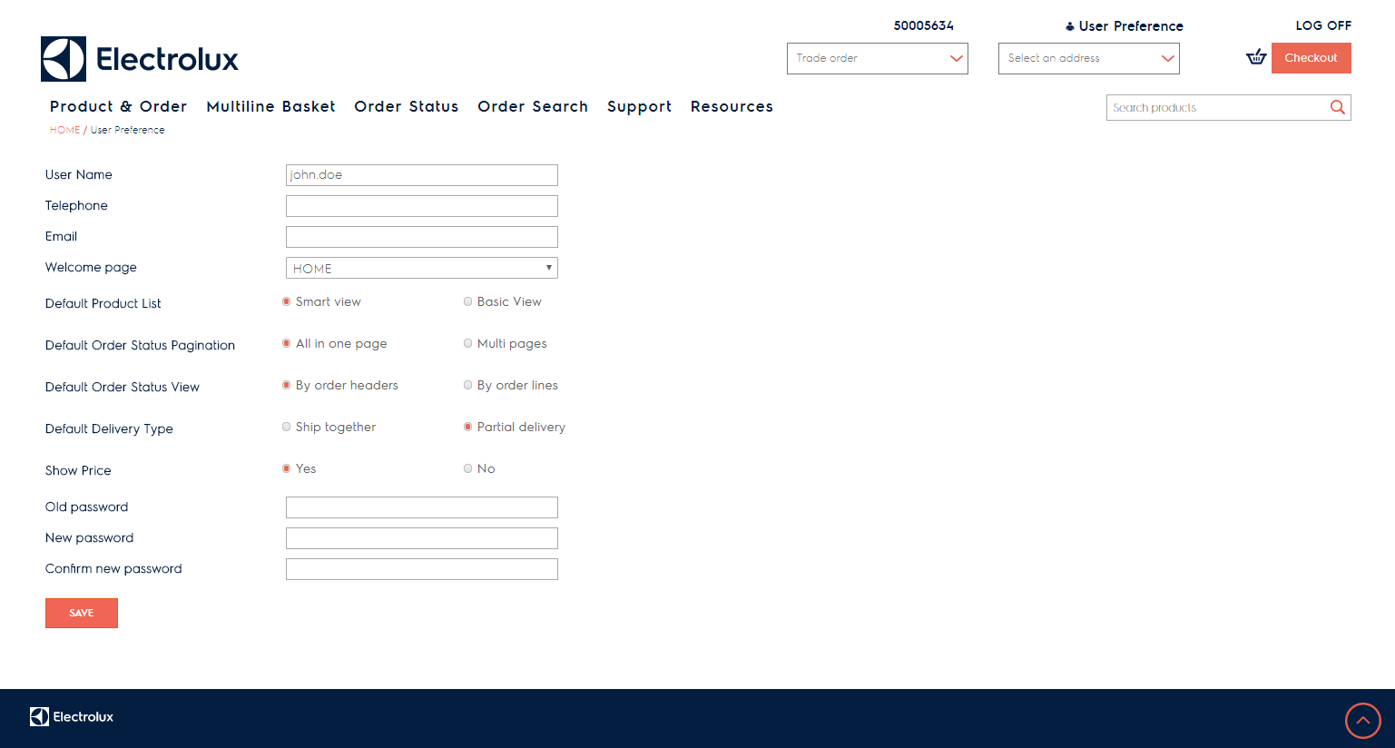
User Management: Edit your preferences
Standard User
View & update your basic profile and contact details
Access to user preferences is always in view
Update your site navigation defaults: preferred landing page, level of detail on product lists, and order status.
Update delivery split preferences & price visibility across the site
Update your password

Slide 21
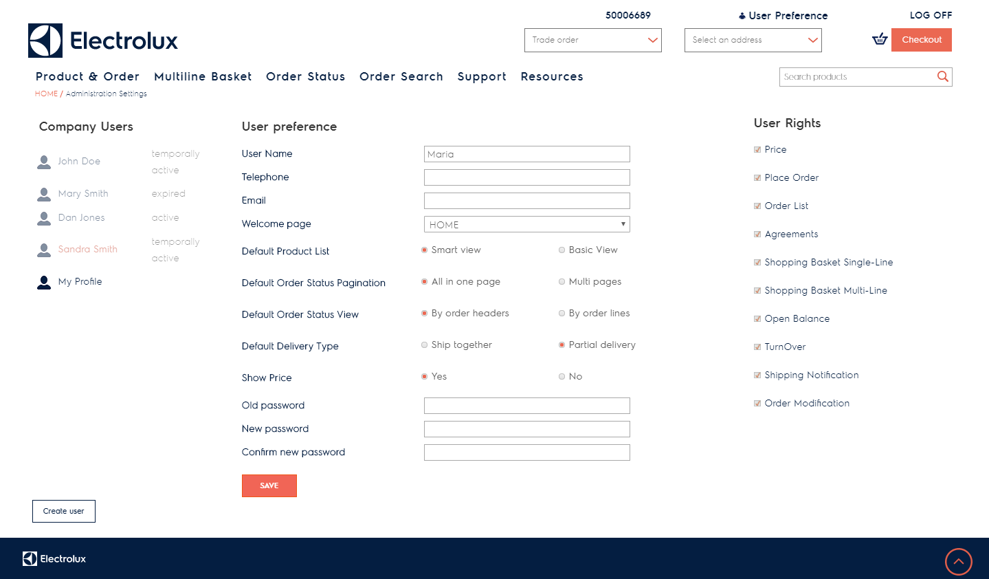
User Management: Edit your preferences
Company Admin User
View the list of site users from your company
Access to user preferences is always in view
User status (active or expired) is displayed next to each username. You can extend the timespan of the user‘s access by editing the Expiration date field when the user is selected.
You can restrict access to certain site functionalities, by unchecking items in the user rights list
Changes to user preferences & User rights are applied to the currently selected user.
By default, your profile will be the one selected in the list

Slide 22
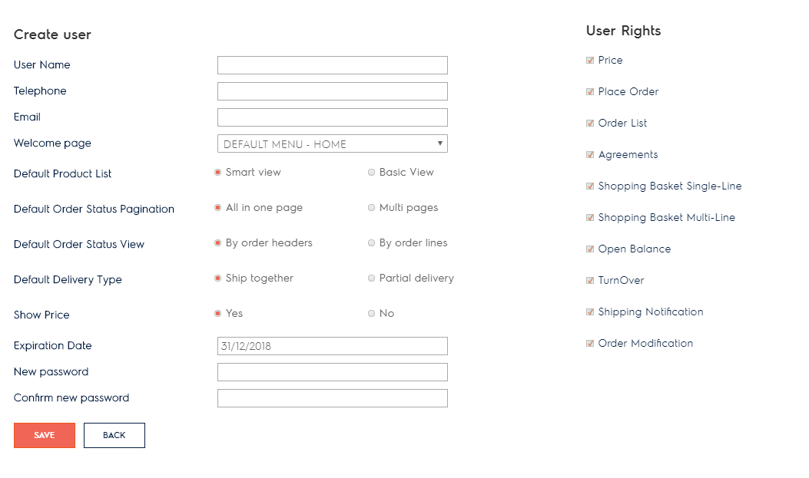
User Management: Edit your preferences
Company Admin User: Create user
Fill in the new user‘s credentials, preferences and select his/her user rights.
When you Save the info, an email is triggered to our customer service desk, who will confirm the new user account
Using the Create User button you launch the menu giving you the option to input the credentials of a new user within your company

Slide 23
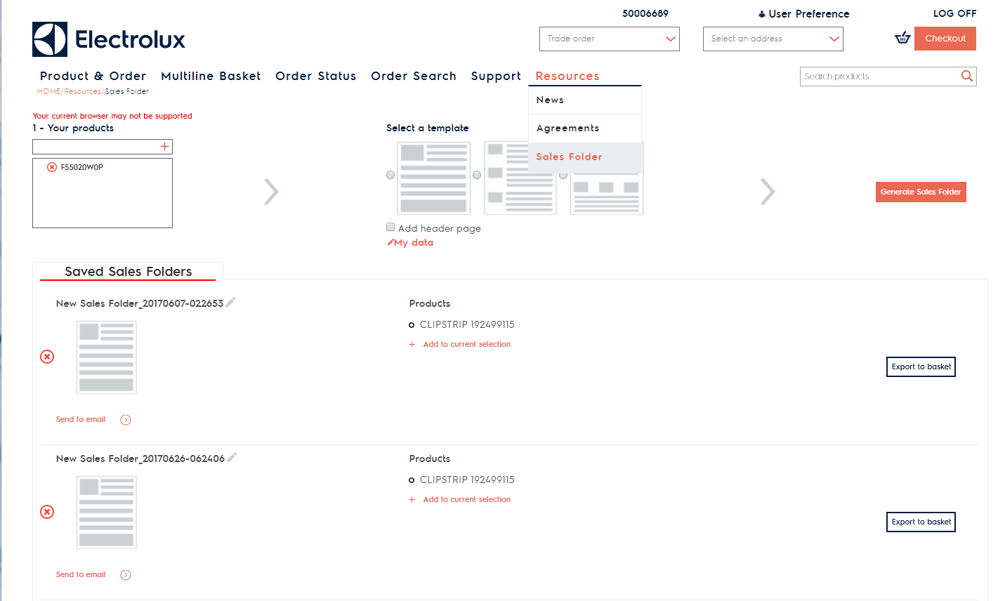
Additional Resources: Sales Folder
By default, the products in your cart will display in the selected products panel.
You can add more products directly by keying in the Electrolux product/model number in the input field, and select from the dropdown suggestions
Access the Sales Folder, our product brochure generator, from the Resources menu.
While you‘re navigating the site, you also get the option to move products to the sales folder (on the product list, in the fast cart and the checkout page)

Slide 24
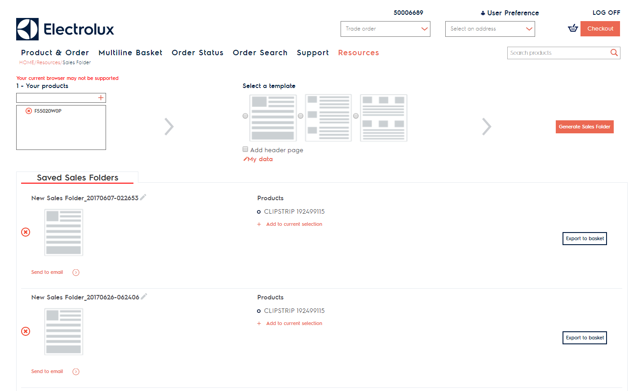
Additional Resources: Sales Folder
After you finalized your product selection, select a template to use – choose between one, three or six products per page.
Existing sales folders will displayed in the list
You can open an existing sales folder clicking on the thumbnail or its name
You can also add a cover page to your brochure and edit the information displayed via My data.
You can also rename (via edit icon), send folder to an email, or remove existing sales folder
The final step is to Generate Sales Folder, which will open your newly created brochure

Slide 25
Additional Resources: Sales Folder
You can add products from an existing sales folder to your current selection via Add to current selection – this gives you the option to merge/bundle products from several sales folder into one.
You can move products from your sales folder to your current basket. After pressing Export to basket, you will be redirected to the checkout page.

Slide 26
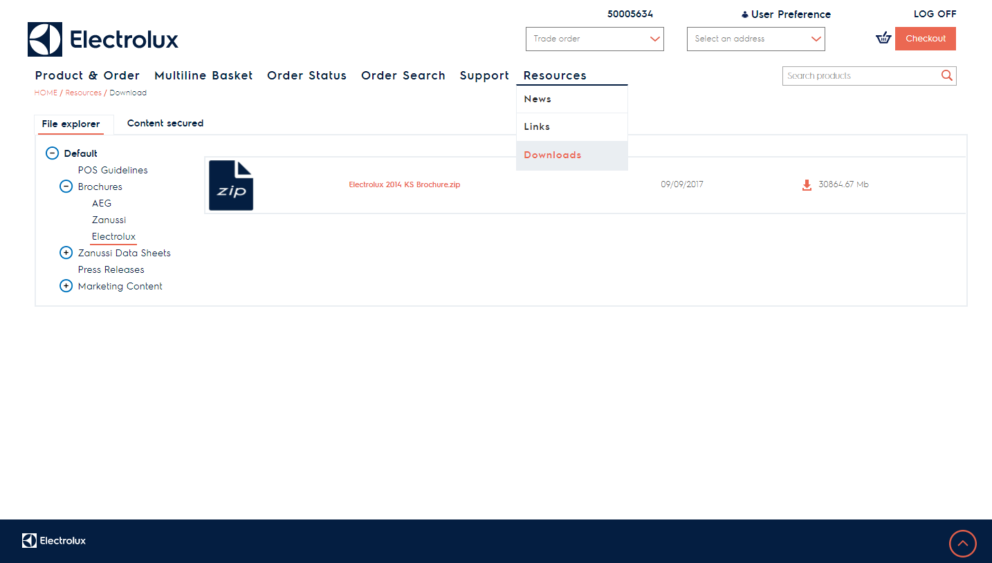
Additional resources: Downloads
In the first tab, you can view and download content public to all B2B users.
Access the Downloads area from the Resources top menu item
In the second tab, you can view and download exclusively made available to your company.
Download the material by pressing the symbol next to the file size, or the file name.
Navigate the list of context by expanding & collapsing folders. Click on the folder name to view ist contents in the table

Slide 27
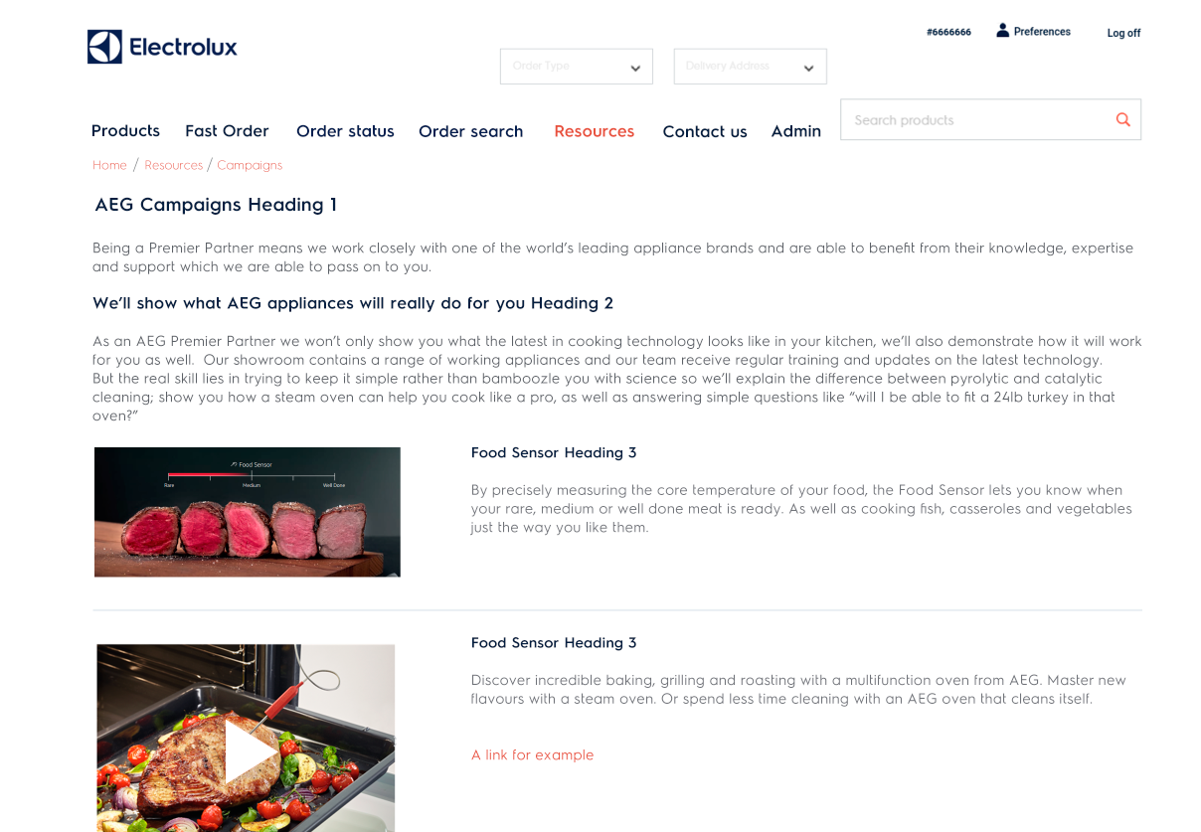
Additional resources: News & inspiration
Keep up with the latest news and platform links from Electrolux from the Resources top menu item
Your local content here
On the News page, we keep you updated with the latest B2B platform improvements, latest product & campaign information.
On the Links page, we have gathered for you all relevant Electrolux platforms

